Slide 1
Euclidean TSP Between Two Nested Convex Obstacles
Jeff Abrahamson、Ali Shokoufandeh and Pawel Winter
Information Processing Letters, (95) 370–375, 2005
Presenter： Shiuan-Wen Chen
Date： Feb. 12, 2006

Slide 2
Abstract
We present a polynomial-time algorithm for a
variant of the Euclidean traveling salesman tour
where n vertices are on the boundary of a
convex polygon P and m vertices form the
boundary of a convex polygonal obstacle Q
completely contained within P. In the worst
case the algorithm needs O(m² lgm+m²n) time
and O(nm+m²) space.

Slide 3
Basic Definitions
Proposition 1 Let abc be a triangle and C a convex chain in its interior between a and c of length ||C||.
Then d(a, b) + d(b, c) > ||C||.
a
C
b
c

Slide 4
Basic Definitions
Let p₁, . . . , p_{n} denote the vertices of P and q₁, . . . , q_{m} be the vertices of Q, m ≥ 3.
we will assume that vertices are numbered in the clockwise direction.
Visible
A path π = u₁ ~> u_{k} = u₁u₂⊕u₂u₃⊕. . .⊕u_{k−1}u_{k}, where ⊕ denotes edge concatenation.
If π = u₁ ~> u_{k} is a path and u₁ = u_{k}, then the path is called a tour.
A simple tour T has no duplicate vertices except the necessary first and last.

Slide 5
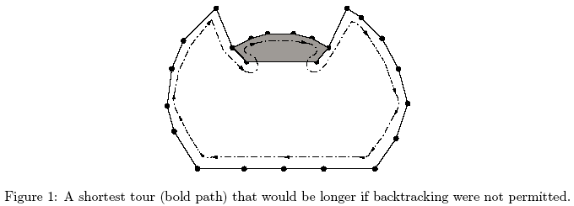
Basic Definitions
A tour T is weakly-simple if it has no intersections except possibly for backtracking( … ⊕ vv’ ⊕ v’v ⊕ …, see figure 1)
cross-over edges
polygon edges
obstacle edges

Slide 6
Basic Definitions
Define || q_{i} ~> q_{j} || to be the length of the polygonal path q_{i} ~> q_{j} = q_{i}q_{i+1} ⊕ . . . ⊕ q_{j−1}q_{j} .
Note that the path q_{i} ~> q_{j} is clockwise, and that (q_{i} ~> q_{j}) ⊕ (q_{j} ~> q_{i}) = Q.
A clockwise detour d^{k}_{i,j} of p_{k}p_{k}⁺, for any pair of (not necessarily distinct) Q-vertices q_{i} and q_{j} to be the path
d^{k}_{i,j} = P_{Q}(p_{k}, q_{i}) ⊕ (q_{i} ~> q_{j}) ⊕ P_{Q}(q_{j} , p_{k}⁺ ), where P_{Q}(u, v) denotes a shortest obstacle-avoiding path from u to v.
The incremental cost c^{k}_{i,j} of the detour d^{k}_{i,j} is
c^{k}_{i,j} = ||P_{Q}(p_{k}, q_{i})|| + ||q_{i} ~> q_{j}|| + ||P_{Q}(q_{j} , p_{k}⁺ )||
− ||p_{k}p_{k}⁺|| .

Slide 7
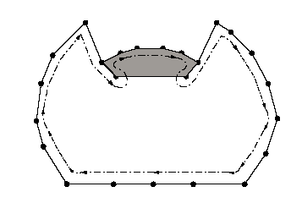
Basic Definitions
Let d_{i,j} denote a cheapest clockwise detour through q_{i} ~> q_{j} taken over all polygon edges p_{k}p_{k}⁺ . Set d_{i,j} = argmin{d¹_{i,j} , d²_{i,j} , . . . , d^{n}_{i,j}} and let c_{i,j} = min{c¹_{i,j} , c²_{i,j} , . . . , c^{n}_{i,j}}. That is, d_{i,j} is a detour of cost c_{i,j} .
p_{k}
P_{k}⁺
q_{i}
q_{j}

Slide 8
Structural Properties
It will facilitate a transformation of the original problem to m shortest paths problems in an appropriately defined digraph G.
Lemma 2 An optimal tour T has intersections only on Q vertices.

Slide 9
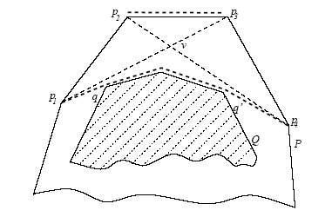
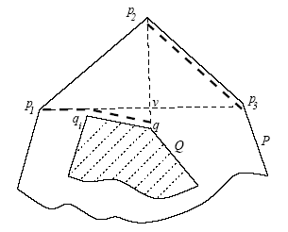
Proof of Lemma 2
1. All four vertices are on P.
2. Three vertices are on P and one on Q.

Slide 10
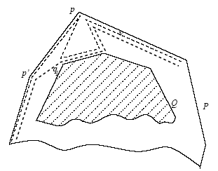
Proof of Lemma 2
4. Two vertices are on P and two on Q, with p1 = p2.
3. Two distinct vertices are on P and two on Q.

Slide 11
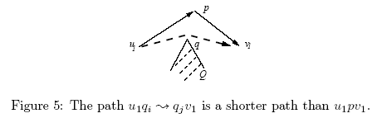
Structural Properties
Lemma 3 There exists a shortest tour T that visits each P-vertex exactly once.

Slide 12
Structural Properties
Corollary 4 There exists a shortest tour T on which P-vertices preserve their cyclic order.
Corollary 5 Other than backtracking, a shortest tour visits vertices of Q in cyclic order as well.
Lemma 6 If a shortest path is clockwise on P but counterclockwise on Q, then T has precisely one detour
from P to Q.

Slide 13
Algorithm
Case1: the shortest tour with same orientation on P and Q
  Let G = (V,E) be a directed weighted graph with V = {x₁, . . . , x_{m}, y₁, . . . , y_{m}} conceptually equal to the vertices of Q repeated twice, with q_{i} represented at x_{i} and again at y_{i}. The edges (v_{i}, v_{j}) have weight w(v_{i}, v_{j}), where w(x_{i}, y_{j}) = c_{i,j} and w(y_{i}, x_{j}) = 0 if j = i or j = i + 1 and ∞ otherwise, where subscripts are interpreted modulo m and c_{i,j} is the cost of the cheapest detour d_{i,j}.

Slide 14
Algorithm
  Then one of the m shortest paths from x_{i} to y_{i−1} corresponds to a shortest obstacle avoiding tour of P and Q:
  Theorem 7 For each 1 ≤ h ≤ m let π_{h} be the shortest path from x_{h} to y_{h−1}. Let π be the π_{h} with shortest length. Then π corresponds to a shortest same-orientation obstacle avoiding tour through all P and Q vertices.

Slide 15
Algorithm
the path T corresponding to π is a weakly-simple tour and may be thought of as a cyclic tour of P plus the cost of one or more detours to Q. It has length |P|+|π _{h}|
X₂
C_{2,3}
C_{2,1}
0
C_{2,2}
C_{1,2}
Y₂
0
C_{3,2}
Y₁
Y₃
0
C_{1,1}
0
0
0
C_{3,3}
C_{1,3}
X₁
C_{3,1}
X₃

Slide 16
Algorithm
Case2: the tour on Q has opposite orientation than on P. By Lemma 6, a shortest tour T will omit precisely one edge of P and one edge of Q. We need, therefore, only consider the shortest detour for each candidate edge of Q. The shortest tour, then, is the shorter of the shortest same orientation tour and the shortest opposite-orientation tour.

Slide 17
Complexity
Theorem 8 Finding the shortest tour of P and Q vertices requires O(m²lgm+m²n) time and O(nm+m²) space.

